Slide 1

Video Presentation
Please see the recording of our presentation at https://vimeo.com/521705169

Slide 2



Austin Predictions: Securing a Stronger and Bolder Housing Market
Anique Khawar, Chelsea Clinger, Eric Pierce, Jose Sifontes, Owen Nguyen

Slide 3





Introductions
Anique Khawar
Chelsea Clinger
Eric Pierce
Anique is currently an aspiring data scientist with a specialty in data engineering and modeling.
Chelsea is currently a Data Analyst II at Brightway Insurance conducting firm wide analytics.
Eric founded and is the Vice President of Epsilon’s Solutions and Integration Engineering group.
Jose Sifontes
Owen Nguyen
SVP, Enterprise Data Officer for a South Florida based financial institution.
Owen is a Product Specialist for Iress providing technical and business solutions for Fintech institutions.

Slide 4
Contents
1
4
19
OVERVIEW
A brief description of the problem statement and goals undertaken by this project.
DATA OVERVIEW
A brief description of the problem statement and goals undertaken by this project.
APPLICATIONS
A look into the mobile and web applications as well as the insights dashboard
2
10
22
DELIVERABLES
A look into each of the deliverables provided
DATA CLEANING
A brief description of the problem statement and goals undertaken by this project.
RECOMMENDATIONS
A brief description of the problem statement and goals undertaken by this project.
3
11
27
APPROACH
Look into the approach taken by Area 51 to ultimately provide the deliverables
MODEL CREATION
Insight into each of the three model types created for this project
CONCLUSIONS
A synopsis of the work completed by Area 51

Slide 5

Overview
Business Model
Brookfield Residential Properties Inc. is a leading North American land developer and homebuilder.
Entitles and develops land to create master-planned communities.
Problem Statement
With the use of data analytics, Brookfield Residential Properties has contracted Area 51 Consulting to explore the Austin market and make recommendations to improve business operations.
Opportunity
We hope to leverage data analytics and data science to discover factors that contribute to home prices in Austin.

Slide 6
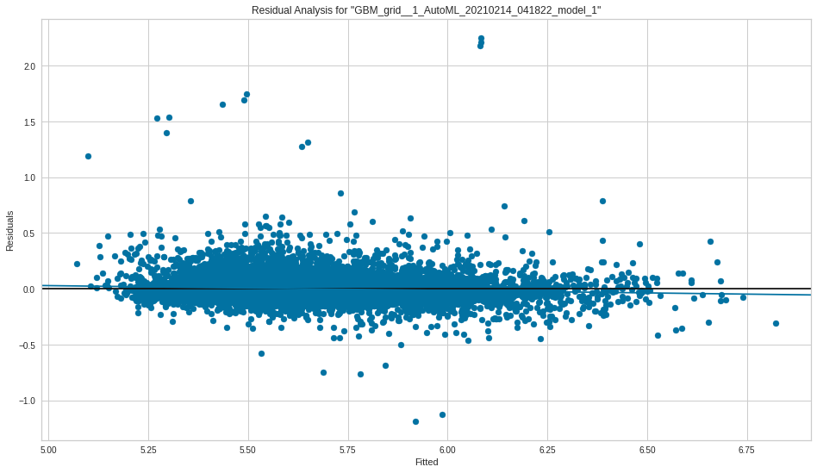
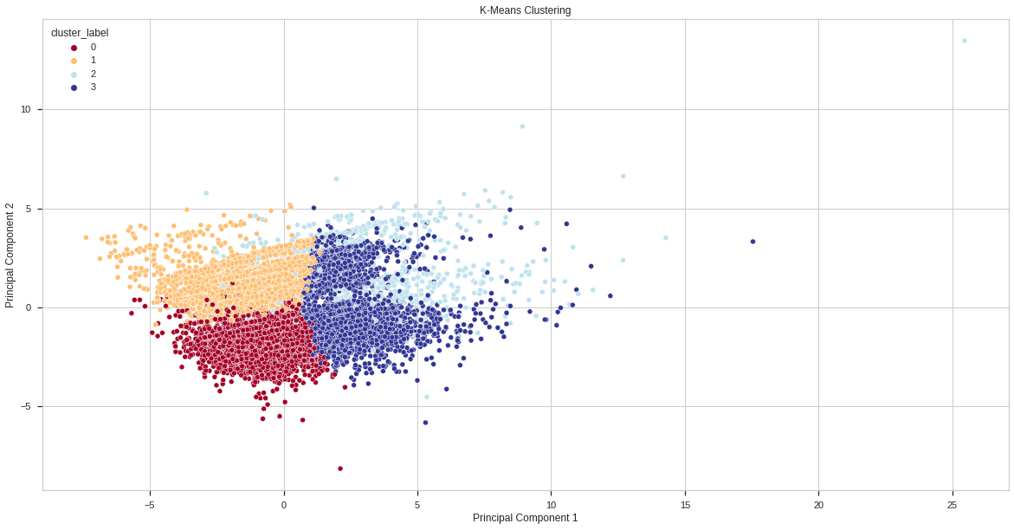
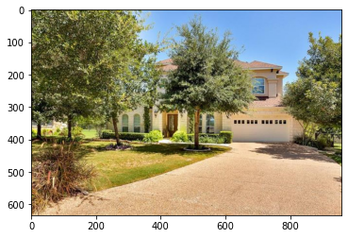
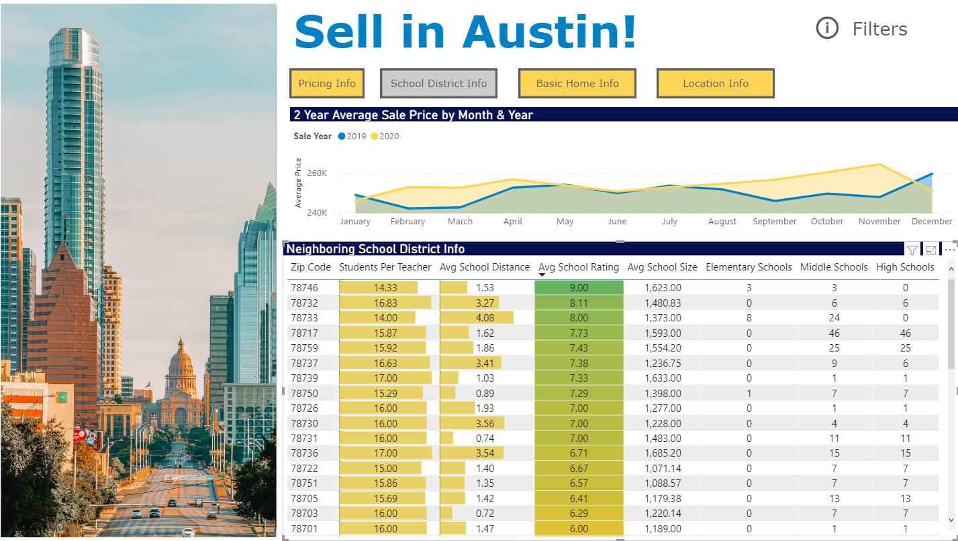
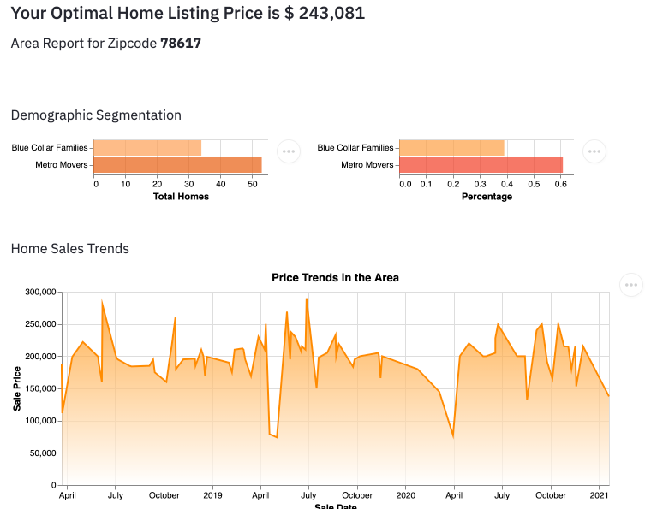
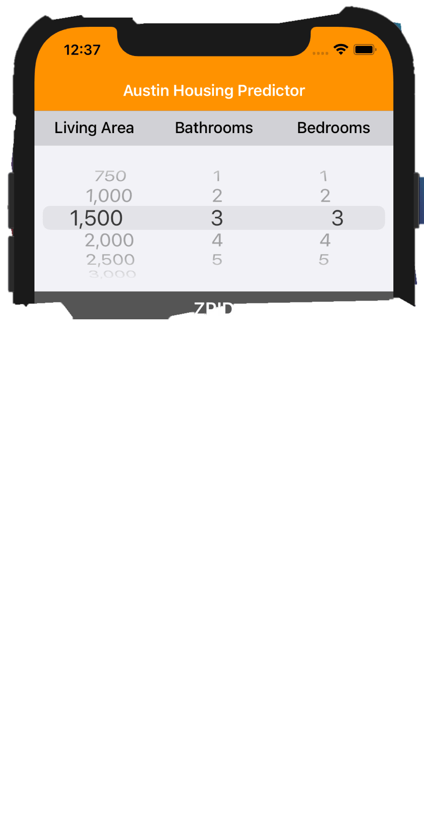
Deliverables
#1. Regression Models
#2. Cluster Model
#3. Computer Vision Model
#4. Analytical Dashboard
#5. Web Application
#6. Mobile Application

Slide 7
Approach
Obtain Data
Clean Data
Exploratory Analysis
Model
Interpret
The dataset utilized in this analytical endeavor is sourced from a scraping of Zillow listings via a data scraping service from Apify.
Dropped any columns with exclusively missing data or duplicates
Limited dataset to latitude and longitude to Austin only
Selected only the most recent price
Created 29 new features
Our team will produce a comprehensive descriptive analysis of the data, its makeup, trends, and observations.
This analysis will enable our team to develop recommendations to our client for better home pricing in the Austin market.
Customer Segmentation
We are using unsupervised learning algorithms to create groups of sold homes sharing similar characteristics
Price Prediction
We developed price prediction models in contrast using a series of regression techniques
In order to enable our client to have a robust understanding of their customer base and methods to increase return on investment we will provide the following:
Insights dashboard
Mobile Application
Web Application

Slide 8
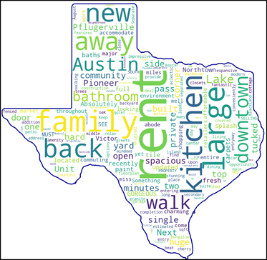
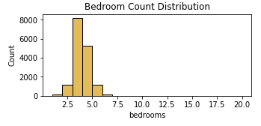
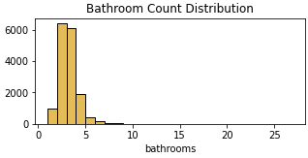
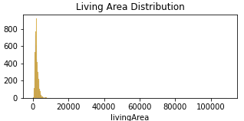
Data Overview
What do houses in Austin look like?
Majority of houses in Austin is single-family type
Between 3-4 bedrooms
Between 2-3 bathrooms
~2,200 square feet
This information will assist with future developments and attracting the correct customers.

Slide 9
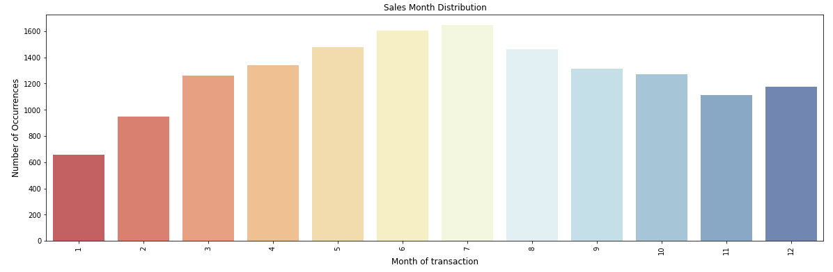
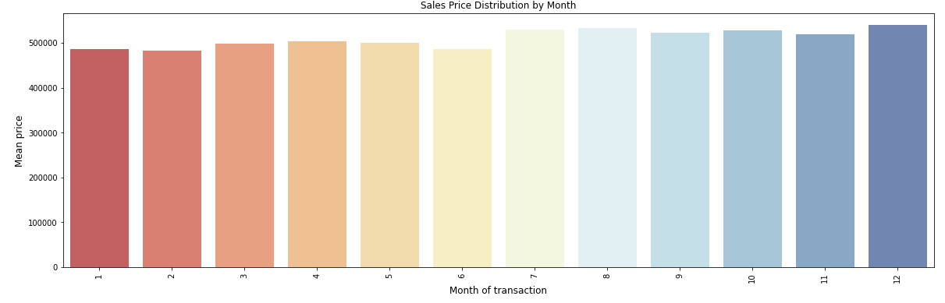
Data Overview
Sale Distribution by Month
When do invest in the Austin Market?
Home sales typically occur in the summer months
Prices are highest in July, August and December
This analysis can be utilized to ensure that properties are purchased during statistically cheaper months and sold during timeframes of higher expected returns.
Price Distribution by Month

Slide 10
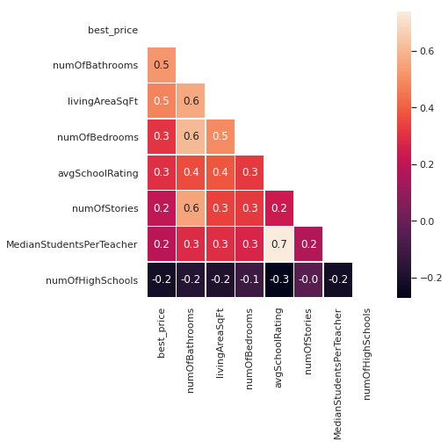
Data Overview
Correlation Matrix
What aspects correlate with sale price?
Strong positive relationships exist between sale price and:
Bathroom count
Bedroom count
Living area square feet
School rating
Number of stories
Mean students per teacher
Strong negative correlations exists between sale price and:
Number of high schools

Slide 11
Data Transformation
Count Feature Creation
Deduplication and Filtering
Removed
Duplicate properties
Columns with all nulls
Rental properties
Filtered
Latitude between 30 and 31
Longitude between -90 and -97
Feature Creation and Cleaning
31 additional new features were created including the count features on the right
Variable | Description
# of Accessibility Features | Number of unique accessibility features listed
# of Appliances | Number of unique appliances listed
# of Community Features | Number of unique community features listed (i.e., conference rooms, cluster mailboxes)
# of Elementary schools | Number of Elementary schools in area listed
# of High schools | Number of High schools in area listed
# of Middle schools | Number of Middle schools in area listed
# of Parking Features | Number of parking features (unique entries such as an attached garage or a parking spot)
# of Patio and porch features | Number of patio and porch features listed
# of Photos | Number of photos provided for a listing
# of Primary schools | Number of Primary schools in area listed
# of Security Features | Number of unique security features listed
# of Waterfront Features | Number of waterfront features listed (if a property is near a body of water.)
# of Window Features | Number of window features listed (if windows come with blinds, double pane, and vinyl windows, etc.)

Slide 12
Customer Segmentation
Goal
Create listing segments that the client can utilize to align advertisements
Model Creation
We conducted principal component analysis (PCA) across the data and determined that roughly 90% of variability in the data can be explained with half (26) of the features
K-means clustering was utilized to segment homes based on nearest
mean value.
Results
Ultimately the k-means clustering algorithm produced four unique
clusters of customers.
Combining this analysis with secondarily sourced demographics data,
we were able to uncover more information about these individuals

Slide 13
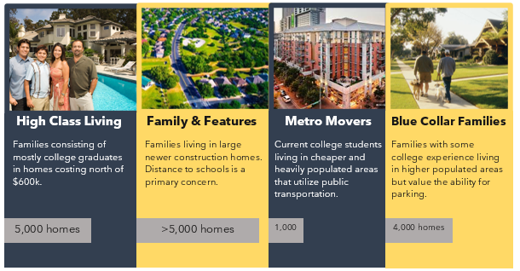
Clustering Overview

Slide 14
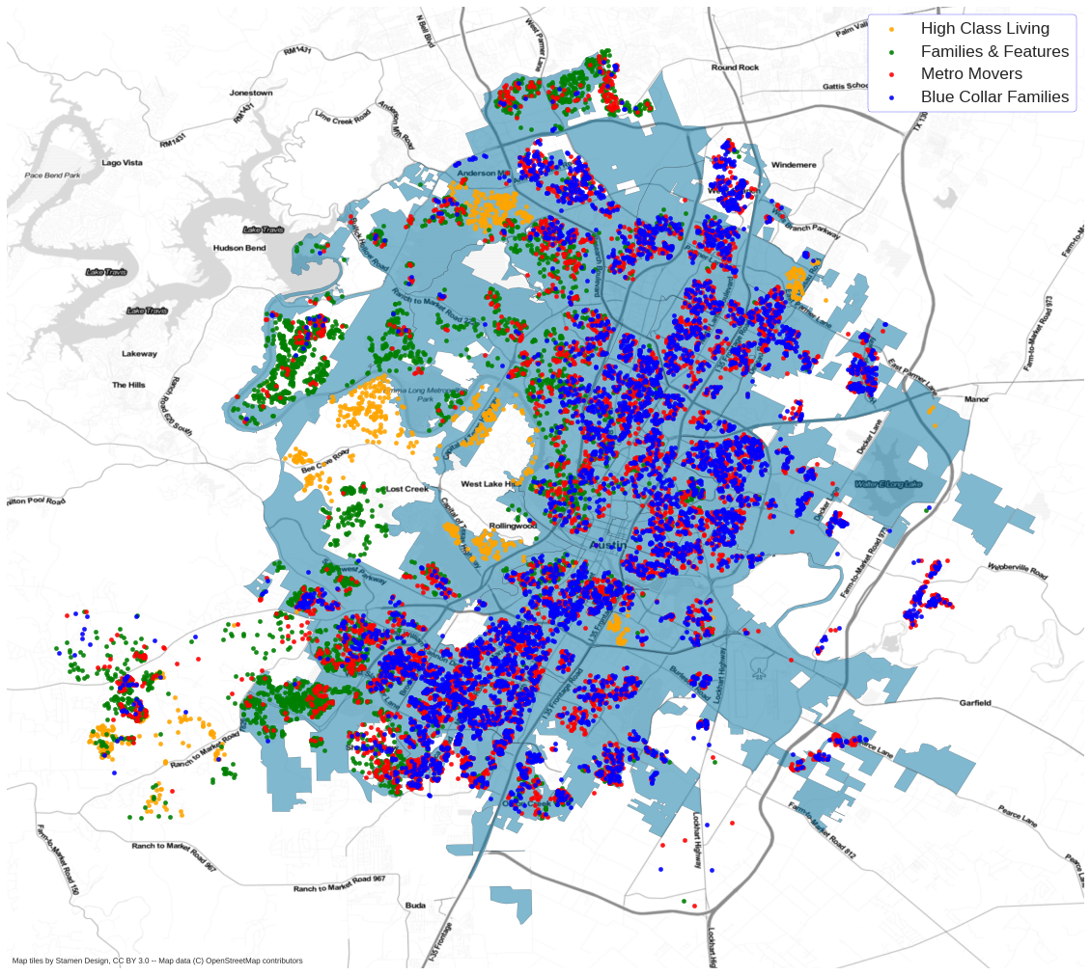
Customer Segmentation
Center and west Austin tend to have higher priced homes than average, therefore it is not surprising that our High Class Living and Family clusters are located central and west while the Blue Collar cluster is situated farther east.

Slide 15
Price Prediction
Goal
Assist agents in listing their properties with the most optimal selling price
Model Creation
Eliminated relationships with over 80% correlation
Employed a 70/30 percent train-test split
Utilizing regression techniques, we leveraged a model tournament system to execute and rank several models

Slide 16
Price Prediction
Evaluated Model Types:
Linear Regression
Linear Regression with PCA Reduction
Lasso Regression with 5-fold Cross-Validation
Lasso Regression with 5-fold Cross-Validation and PCA Reduction
ElasticNet Regression with 5-fold Cross-Validation
ElasticNet Regression with 5-fold Cross-Validation and PCA Reduction
Random Forest Regression
Gradient Boosting Regression
Bagging Regression
AdaBoost Regression
Decision Tree Regression
Ensemble Regressor (Random Forest, Gradient Boosting)
XGBoost Regressor
Tuned Random Forest Regressor
Automated Machine Learning Regressor (AML)
Deep Neural Net Regression

Slide 17
Price Prediction
Results
The Automated Machine Learning (AutoML) model was the winner of the tournament
This is due to a few key components:
AutoML conducts a secondary tournament
Incorporates gradient boosting, XGBoost and Stacked Ensemble models
Has protections against sample inaccuracies and leakage
Includes automated hyperparamenter turning
Despite these advantages, the Random Forest Regression model is a very close second place.
Model_Name | MSE | RMSE | R2 | MAE
AutoML Regression | 0.02 | 0.13 | 0.71 | 0.07
Tuned Random Forest Regression | 0.02 | 0.13 | 0.70 | 0.08
Ensemble Regression | 0.02 | 0.13 | 0.70 | 0.08
Random Forest Regression | 0.02 | 0.13 | 0.70 | 0.08
Bagging Regression | 0.02 | 0.14 | 0.68 | 0.08
XGBoost Regression | 0.02 | 0.14 | 0.68 | 0.08
Gradient Boosting Regression | 0.02 | 0.14 | 0.68 | 0.08
Linear Regression without PCA | 0.02 | 0.14 | 0.65 | 0.09
Lasso Regression without PCA | 0.02 | 0.14 | 0.65 | 0.09
ElasticNet Regression without PCA | 0.02 | 0.14 | 0.65 | 0.09
Neural Network Regression | 0.02 | 0.14 | 0.65 | 0.09
Linear Regression with PCA | 0.02 | 0.15 | 0.63 | 0.09
Lasso Regression with PCA | 0.02 | 0.15 | 0.59 | 0.10
ElasticNet Regression with PCA | 0.02 | 0.15 | 0.59 | 0.10
ADABoost Regression | 0.03 | 0.18 | 0.42 | 0.13
Decision Tree Regression | 0.03 | 0.19 | 0.41 | 0.11

Slide 18
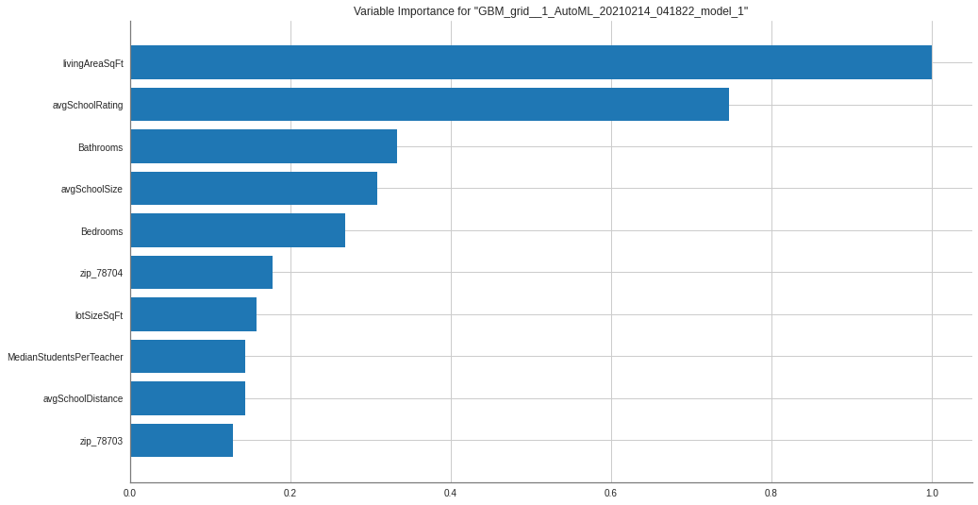
Price Prediction
Variable Importance
The champion model determined that the most important variables in home price prediction to be:
The size of the living area
The quality of the school system
School system size
Relative size of the home in terms of number of bedrooms and bathrooms
Home’s lot size
We also saw zip code and location data playing a significant role in ultimate house price.

Slide 19
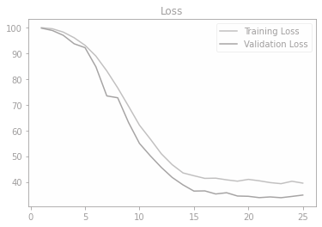
Computer Vision Model
Goal
Leverage the property images on the Zillow property to assist in price prediction
Model Creation
A Convolutional Neural Network was produced for this purpose utilizing a fully connected linear activation function.
This enabled use to utilize image data as the input for a regression based neural network
Results
Produced a mean absolute error percentage of 34.87%
Indicates that the predicted price is 35% off from the actual price
While very accurate for a one variable model Area 51 decided that this was not accurate enough for our clients

Slide 20
Deliverables Overview
Initial Research - Insights Dashboard
Research your target buying or selling location to better understand pricing trends, school related metrics, house feature information, and demographic information
Pricing Help – Web Application
A useful web application to help potential seller price their home, and help potential buyers benchmark the prices of the homes they’re evaluating
Housing Update and Price Impact Help - Mobile Field Agent
Evaluate the impact of making specific updates to your home to the relevant price. Uses dozens of datapoints from your actual listing to determine the pricing impact.
Notes:
Data included features, descriptions, and housing images. We wanted to make sure we were exploring all avenues of data usage, so in addition to the models and word clouds we built, we also leveraged the housing imagery.

Slide 21
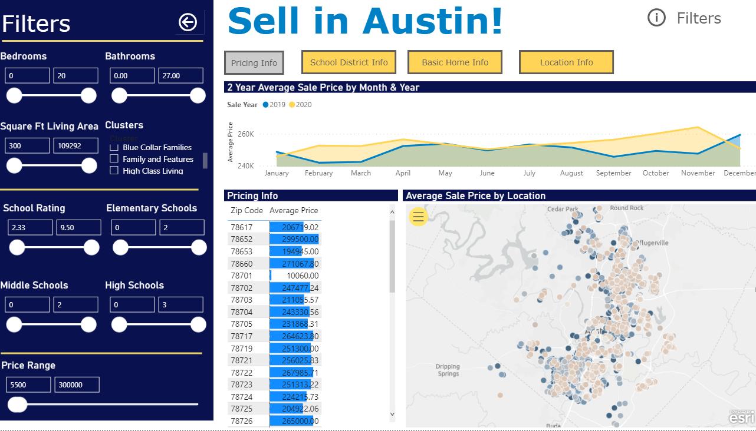
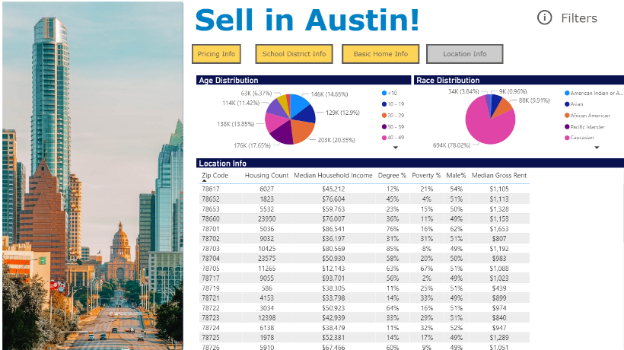
Insights Dashboard
An analytical dashboard has been created to assist agents in understanding the segmentation of existing home sales in Austin.
This dashboard highlights various zip codes based on user selection. The four tabs allow visibility into multiple aspects of each zip code such as buyer demographics, schooling information, pricing details and the features that make up the average home in that area.
Link: area51austin.com

Slide 22
Web Application
Our Home Pricing Prediction web application is built on a responsive web framework that scales all pc, mobile, and tablet browsers.
Price Prediction
The output of this tool is the optimal price a seller should list their house at
Home Sale & Demographic Trends
Additionally, the seller is shown an analysis of other buyers in the area as well as graphics to understand the pricing landscape of the area
Link: http://app.area51austin.com/

Slide 23

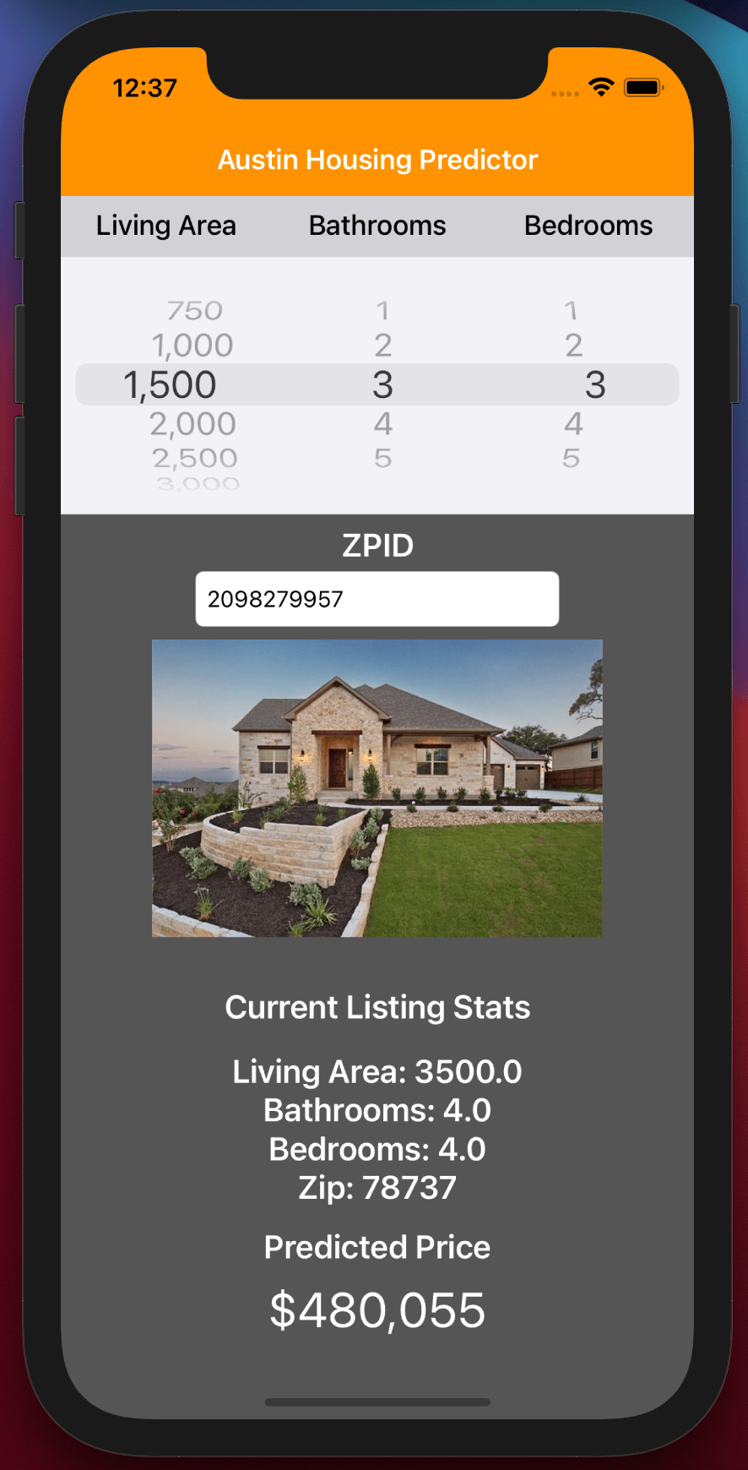


Mobile Application
The Austin Housing Field Agent is a simple mobile app to show home listers how their specific housing listing would be impacted by making updates to their property.
Development
Native iOS application
Developed utilizing Apple’s Xcode development environment
Functionality
Users can select between multiple significant variables to determine the impact of undertaking adjustments to their home on their potential sale price
Adjust housing features to create new predictions
Display features and predictions for only the desired property
Output predicted sale price based on new/updated features
Link: https://github.com/eric-pierce/Austin-Housing-App

Slide 24
Recommendations
1
4
PROPERTY DEVELOPMENT
Utilize cluster analysis to align new projects
WEB APP - OPTIMIZE NEW PROJECTS
Leverage model-based pricing recommendations on the fly.
2
5
ADVERTISEMENT STRATEGIES
Utilize cluster analysis to target desirable customer base
WEB APP – MAXIMIZE SALE PRICE
Conduct what-if scenarios to determine ways to increase return on investment
3
INSIGHTS DASHBOARD
Visualize hidden and influential trends in the market

Slide 25
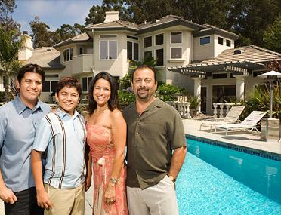
Recommendations
High Class Living
These clients have high income and live with their families. They are willing to pay more to get the best possible property.
Property Development Recommendations
Choose isolated areas with large lot sizes
Use top of the line materials. Do not cut corners to save construction expenses
Advertisement Strategy Recommendations
Focus on safety and comfortability.
Portrait ourselves as trustworthy and luxurious at the same time.
Key Characteristics
Large lot sizes
Less Neighbors
$600k+ homes
Families

Slide 26
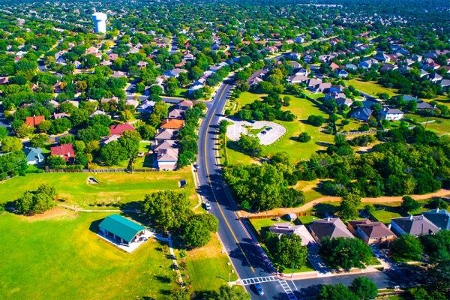
Recommendations
Family & Features
These are middle/upper-middle class families. They are modern and want their kids to be well-educated like them.
Property Development Recommendations
Locate properties in good school districts
Choose suburban locations with large lots
Utilize a more modern architecture style
Ensure communities have desirable amenities such as parks and walking paths for families to enjoy
Advertisement Strategy Recommendations
Paint a positive future outlook
Highlights the modern, comfortable, and convenient amenities
Showcases family values through well-behaved children
Key Characteristics
Large homes
$575k + homes
Must be near schools
Mostly college graduates
Most have amenities
Suburban

Slide 27

Recommendations
Metro Movers
These people are educated but just started out their career. They have entry-level income and are careful with spending. They prefer to save money by avoiding associations and using public transportation.
Property Development Recommendations
Ensure zero or very low association fees
Choose destinations that have multiple nearby methods of public transportation
Very hip and chic design styles
Close distance to popular attractions
Advertisement Strategy Recommendations
Showcase our convenient locations
Utilize viral marketing
Celebrity appearance could make a positive impact
Key Characteristics
High population
Value location
New professionals
Entry to mid level salaries

Slide 28
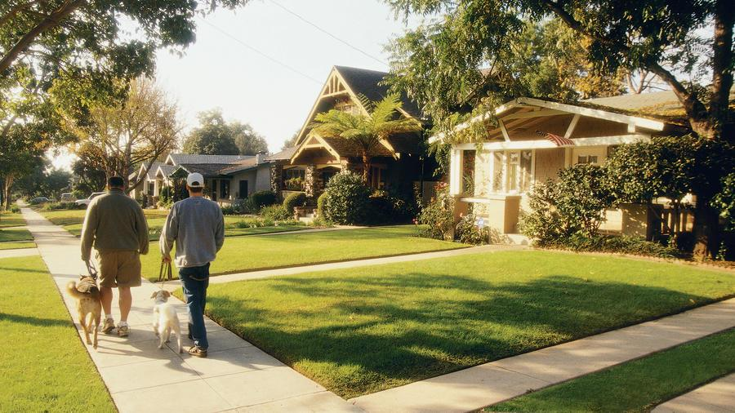
Recommendations
Blue Collar Families
This customer group has lower income. They are extremely conscious spenders. They drive often but do not want to spend too much on parking spaces.
Property Development Recommendations
Ensure zero or very low association fee.
Build large parking garages.
Choose locations that are near free or cheap parking lots.
Choose amenities that require low utility usage.
Advertising Strategy Recommendations
Highlight the cost-efficiency of the properties
Create marketing events that have price discounts
Key Characteristics
High population
No associations
Mid range price
Some college

Slide 29
Recommendations
3. Deploy Insights Dashboard to better understand and take advantage of the Austin housing market
Amend buying and selling schedule to get the best deal.
Plan future projects according to the effect of geographical location on housing price.
Adjust investment strategies based on the geographical price distribution
4. Utilize Mobile App to optimize new real estate projects
Leverage model-based pricing recommendations for properties based on key features as model inputs.
Most important price predictors are: Living Area and School Rating.
5. Apply Mobile App to maximize sale price through home alterations
Conduct what-if scenarios to determine which investments can maximize ROI.
Increasing the number of Bathrooms can significantly increase property price.

Slide 30
Conclusions
In-depth analysis has allowed insights into the Austin consumer base that will benefit our client in multiple ways
Advertising strategies
Property development plans
Etc.
Utilizing multiple price prediction models, Area 51 developed various and unique methods for our client to stay ahead of competition
Utilize the insights dashboard to locate ideal locations for prospective buyers
Harness understandings from the web-application to set the best possible sale price, ensuring a quick and profitable sale
Stay competitive with the mobile application to find simple repairs/improvements to improve sale price

Slide 31
Thank
you!

